Slide 1
FDP Kultivations
Spark MLlib Workshop

Slide 2
Workshop Agenda
Day 1
Intro Big data Scenario
Spark Overview
Rdd's processing with hands on
Day 2
Intro SQL and Big Data motivation
Spark – Dataframe and SQL API
Hand's on
Day 3
Full Exercises Day 1 and Day 2
Day 4
Intro to Spark MLlib (Plus)

Slide 3
Day 4 Spark MLlib
What is Machine Learning
Machine Learning Lifecycle
Spark MLlibs Algorithms
Use Cases for Spark MLlibs
Basket Analysis Lab
Customer Churn Lab

Slide 4
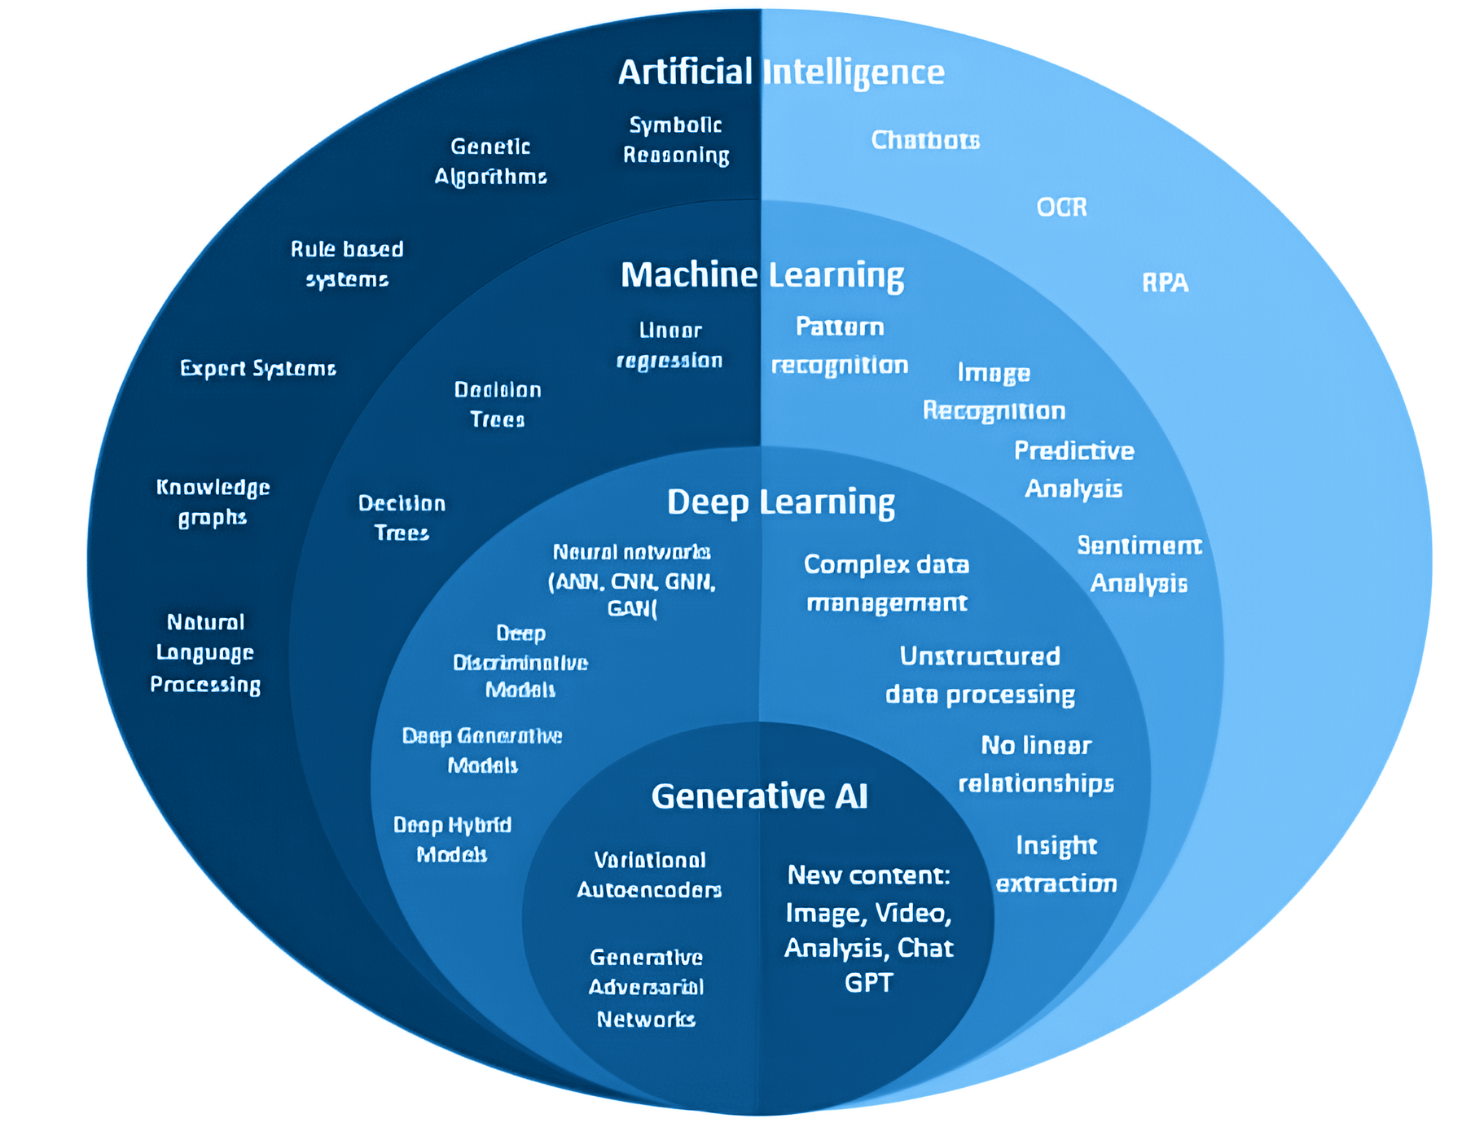
What is Machine Learning?
Machine Learning is a branch of AI that uses algorithms to learn from data and make predictions or decisions without explicit programming.
While many ML algorithms can be deterministic, some exhibit non-deterministic behavior due to inherent randomness.

Slide 5
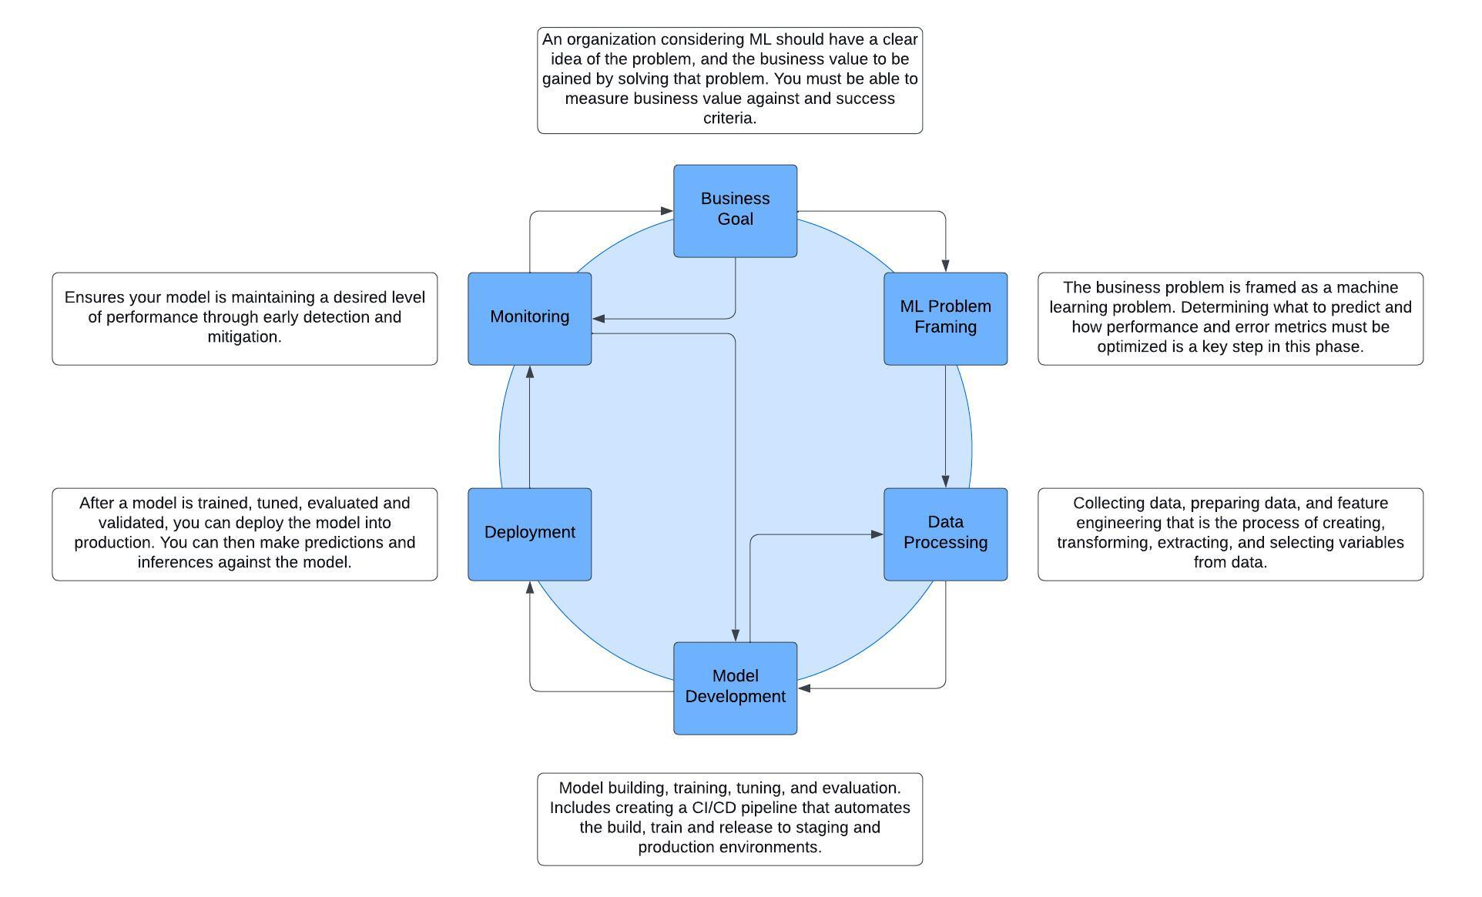
Machine Learning Lifecycle

Slide 6
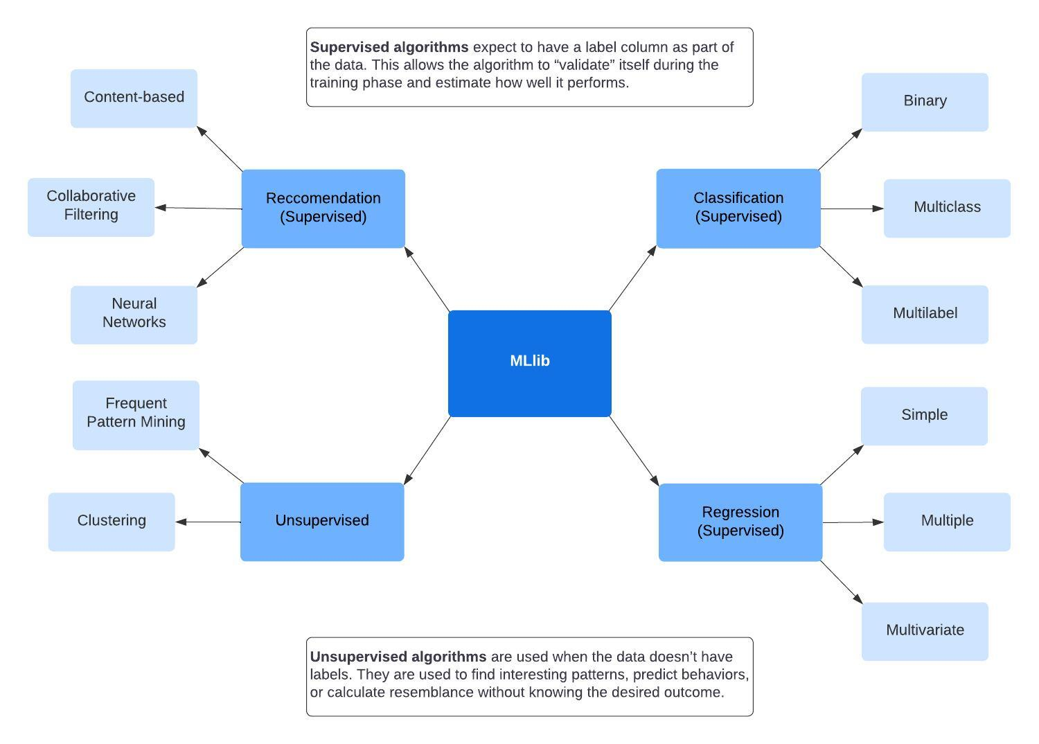
Spark MLlib Algorithms

Slide 7
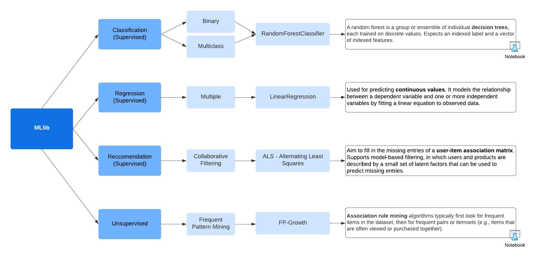
Use Cases for Spark MLlib

Slide 8
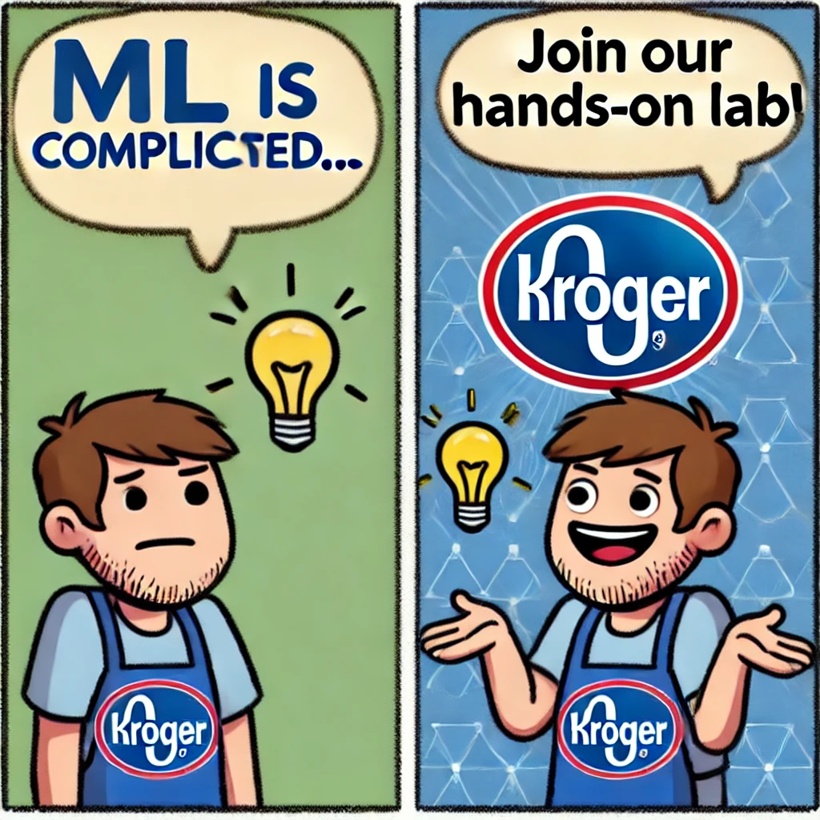
Do you have a quick question?
rodrigo.mattos@kroger.com
Data Engineer - Team Friends From Work

